Slide 1
The land-ice picture of ICESat-2
A brief history of the ICESats
ICESat -2 land-ice product overview
ATL06: the solution to every problem*
Mission status from the land-ice perspective
*some restrictions apply

Slide 2
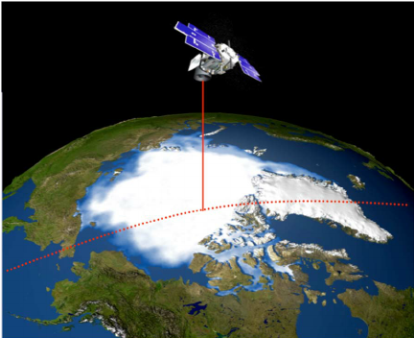
ICESat
ICESat operated from 2003-09
It used a single-beam 1064-nm laser, pulsing 40 times per second
Because the beam could not easily be aligned with the detector’s field of view, the field of view had to be large, which led to substantial forward-scattering-driven elevation biases
The laser lifetime proved unexpectedly short, so to prolong the mission, it was only turned on 60-90 days per year, repeating about 1/3 of its 91-day-repeat orbit
Time-varying laser power led to time-varying elevation biases that have never been adequately calibrated
Received power levels were low late in the mission, leading to lower precision.
Image credit: Ron Kwok

Slide 3
Problems with ICESat-1 … and their solutions with ICESat-2
ICESat-1 | ICESat-2
Short laser lifetime: Coarse temporal resolution | Continuous operation made possible by Low- per-pulse energy Better temporal sampling due to wide beam separation
Coarse spatial resolution | Six-beam configuration, basin-scale measurement
Cross-track slope / elevation change ambiguity | Beam pair repeat measurements
Time-varying instrumental biases | Monitoring using well-characterized targets
Transmit-pulse-power-driven instrumental biases | Adjustable transmit power to maintain consistent Tx/Rx behavior
Transmit-pulse-shape-driven instrumental biases | Monitoring of transmit-pulse shape Explicit treatment of pulse-shape effects in land-ice products
Forward-scattering (cloud/blowing snow) biases | Small receiver field of view / active beam steering Small grain-size dependence of green reflectance lets surface reflectance map cloud properties
Short mission duration (2003-09) | Data should be intercomparable with ICEsat-1 (2003-21?)

Slide 4
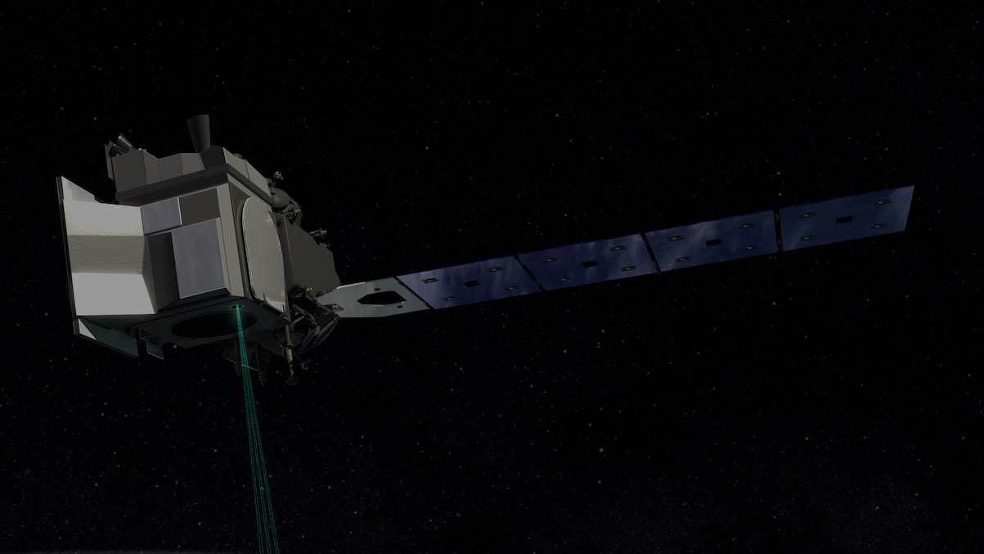
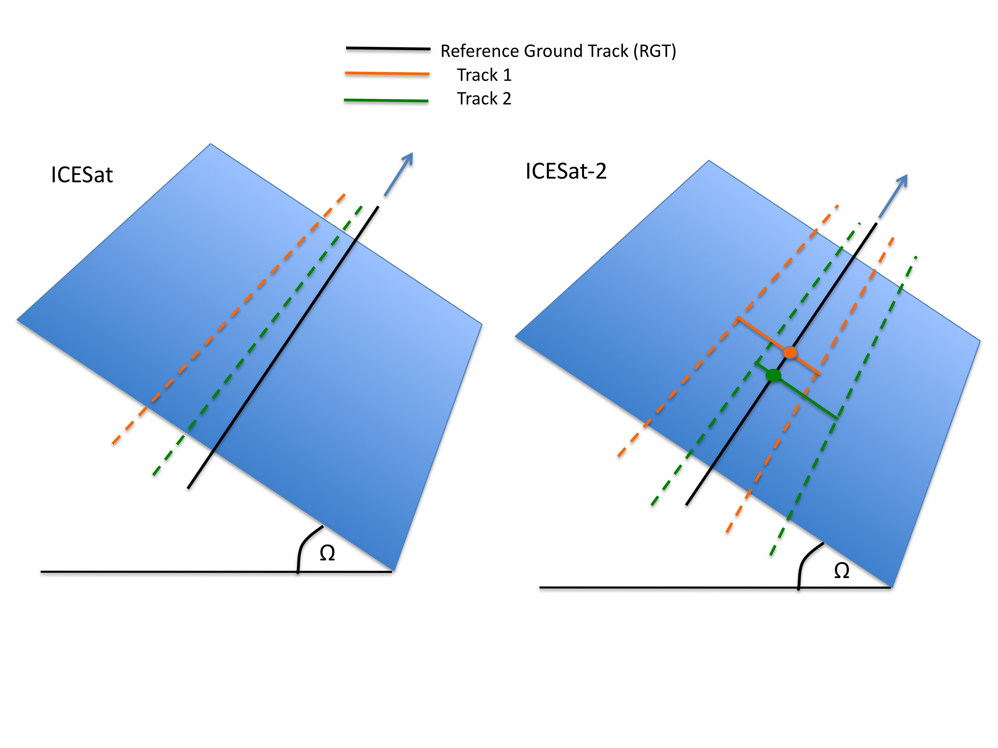
Ice sheets:
Cross-track slope recovery via pairs of beams
91-day repeat orbit
Pointing control requirement: 45 m
Pointing knowledge requirement: 6.5 m
Bias monitoring requirement: 0.2 cm/yr
Slide from Thorsten Markus/ May 2018 GSFC update

Slide 5
Cloud-scattering effects on surface returns
Cloud particles scatter light mostly in the forward direction
Scattered photons that are detected by the satellite have taken longer paths / are delayed
Wider optical fields of view allow detection of more scattered photons
Narrower FOVs reduce forward-scattering biases
Mean centroid delay scales with:
Receiver FOV
Cloud optical depth
Clouds can be detected by:
LIDAR returns (nighttime only)
Reduction in apparent surface reflectance (day or night)
Detected
(wide FOV only
Transmitted
Detected (both)
Wide FOV
Narrow FOV
Spinhirne et al, 2000
Yang et al, 2013

Slide 6
ICESat-2 repeat scheme
ICESat-2’s ground track design is meant to measure exact repeats over glaciers with the maximum spatial and temporal resolution
91-day repeat orbit gives measurements per season for each ground track
Nadir tracks are spaced every ~9 km at 72º
Beam pairs extend 3 km on either side of the nadir track
Gaps between adjacent beam pairs < 3km
Each beam pair measures surface slope, allows correction for cross-track slopes
9 km
3 km
90 m
Notes:
--

Slide 7
ICESat -2 data products
Product | What? | Resolution / posting | Volume Points / 10x10 km box
ATL03 | Geolocated photon-returns | 0.7 m / 0.7 m | >6,000,000 / yr
ATL06 | Surface-height estimates for along-track segments | 40 m / 20 m | 32,000 / yr
ATL11 | Surface height corrected to reference tracks | 120 m / 60 m @ 4/yr | 2,600 reference points 10,400 data points
ATL14 | DEM | 125 m -3 km / 125 m @1/yr | 6400
ATL15 | dh/dt maps | 500 m – 3 km m, 500 m @4/yr | 1600/yr

Slide 8
ATL06 schematic
ATL06 is the lowest-level land-ice-height product
It reports the elevation of 40-meter sloping segments of data, posted every 20 m along track
An iterative fitting strategy tries to select a narrow band of photons that includes the surface
Parameters describing the shape of the surface window help describe how well this process worked

Slide 9
ATL06: land-ice height
Product goals:
Measure the surface at glaciologically meaningful scales
Provide statistically robust elevation estimates
Provide statistics to distinguish high-quality returns from low
Provide cross-track slope information to correct for fine-scale topography
Measurement structure:
Photon heights from ATL03 are fit with 40-meter along-track segments
Segments are coordinated between beam pairs and between repeats
Vertical bounds around the segments help reject background noise
Statistics of the residuals to the segments allow error estimates and bias corrections
50 m
Frame 1: 50-meter airplane with crevasses in the background,
Frame 2: photons returned from one pulse
Frame 3: photons returned from 57 pulses

Slide 10
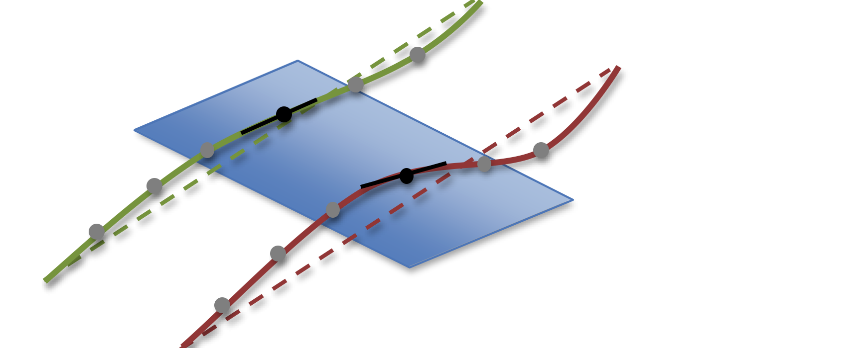
Along-track segments
Segments are centered on points spaced every 20 m along the reference ground tracks
Segment numbers coordinate data between beams in a pair, and between repeats
Along-track coordinate systems measure along-track and across-track positions for photons
ATL06 fits segments in the along-track direction
Beam-to-beam height differences define the across-track slope
ATL11 makes use of slope information in calculating height changes.
reference track
X_{k+1,2,m+1}
x_{k,2,m+1}
X_{k+1,1,m+1}
X_{k+1,2,m}
x_{k,1,m+1}
x_{k,2,m}
X_{k+1,1,m}
x_{k,1,m}
x
y

Slide 11
Along and across-track coordinates
Along-track coordinates (x_rgt) are measured parallel to each reference ground track, starting at the equator, heading North:
0: First equator crossing
~ 6500 km: Southern Greenland, heading north
~10,000 km : Polehole North
~13,000 km : Southern Greenland, heading south
~27,000 km: Northern Antarctica, heading south
~30,000 km : Southern polehole
~33,000 km: Northern Antarctica heading north
Across-track coordinates (y_rgt) are measured perpendicular to the RGT, to the left:
Gt1x: +3000 m
Gt2x : ~0 m
Gt3x : -3000 m
N
Seg azimuth
P_{RGT}
y
RGT
x
P
RPT

Slide 12
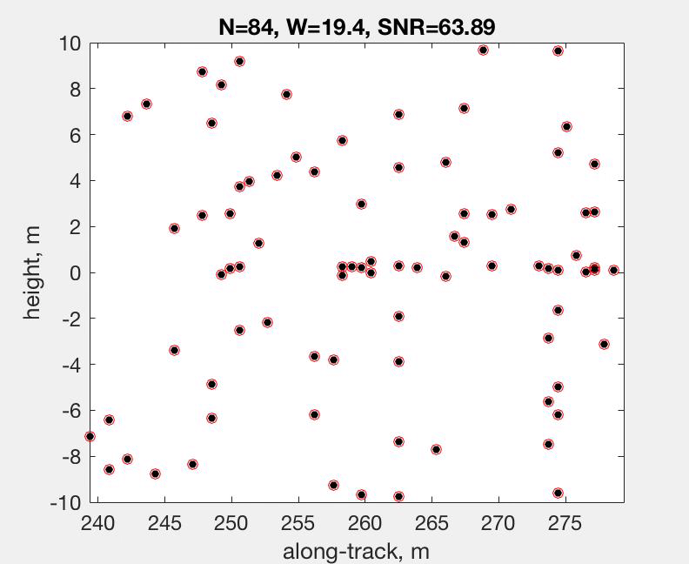
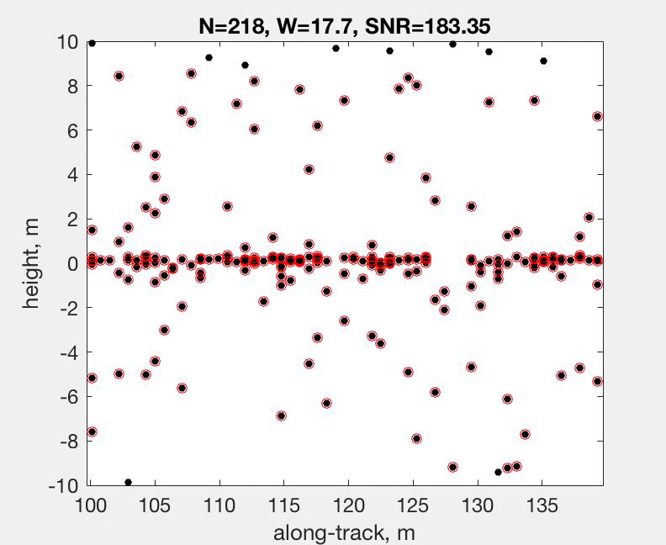
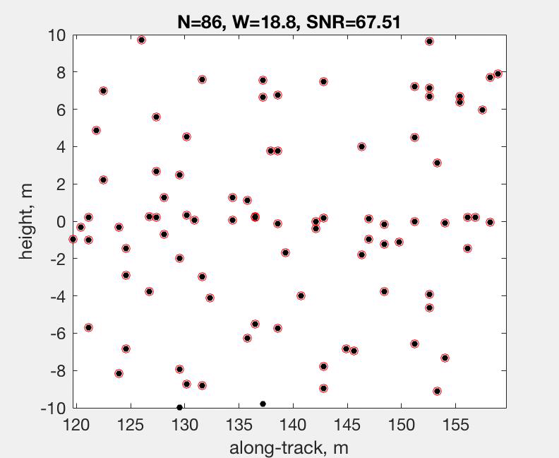
ATL06 algorithm overview
Select photons
Horizontal selection uses 40-meter pre-defined along-track segments
Vertical selection uses ATL03 photon classification, with coarse vertical histograms as a backup
Fit selected photons with a line segment
Iteratively narrow the vertical window to reject noise
Calculate corrections and error estimates using histograms of line-segment residuals
Median-based height estimate
First-photon-bias correction
Transmit-pulse-shape correction
Provide statistics for evaluating the success/failure of the fit
Animation: iterative fitting of a weak-beam segment through moderate clouds

Slide 13
Parameters that help define segment quality:
Misfit statistics
h_robust_spread : estimate spread of the surface heights, taking into account the window size and background rate
rms_residual: the RMS misfit of photons in the window
Window convergence
w_surface_window_final: the width (top-to-bottom) if the returned window
dh_fit_dx : the along-track slope of the refined window
Signal level
r_eff: effective reflectance
SNR: signal-to-noise level
SNR_significance: the chance of the ATL06 algorithm finding
Estimated errors:
h_li sigma: error estimate for h_li
Combined quality flag (see table)
Passes all tests -> atl06_quality_flag=0
Fails one or more tests -> atl06_quality_flag=1
Parameter | Threshold | Description
Signal selection source | <= 1 | Signal selection is based on PE flagged in ATL03.
h_li_sigma | < 1 m | Errors in surface height are moderate or better
snr_significance | < 0.02 | Surface detection blunders are unlikely
Photon density = n_fit_photons/ w_surface_window | >1 /m for weak beams, >4/m for strong beams | Indicates how well the window converged. Large windows and weak signals indicate poor convergence

Slide 14
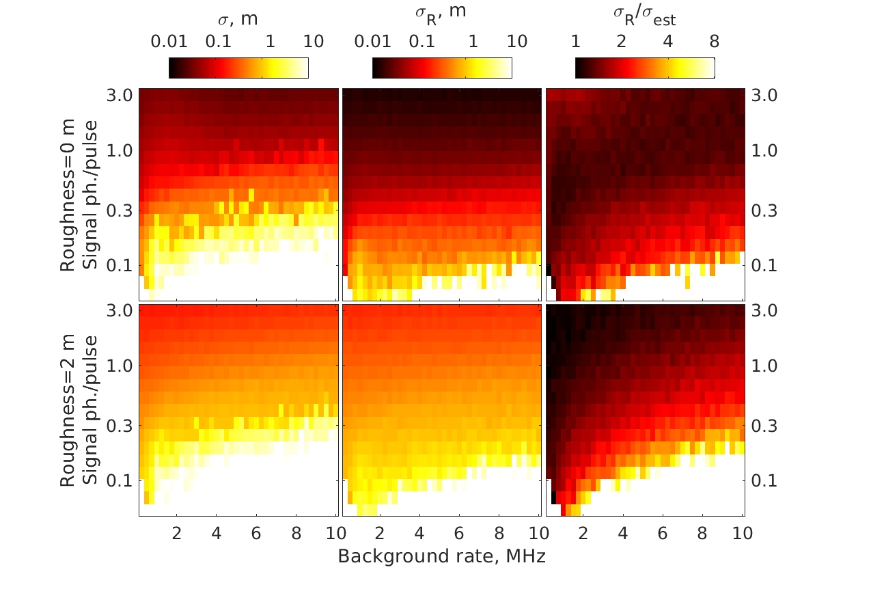
Do ATL06 signal finding and data filtering work?
The fitting algorithm was run on synthetic data to test height recovery as a function of
Signal level (0.03 ph/pulse – 3 ph/pulse
Background photon rate (0-12 MHz)
Surface roughness (0 and 2 m)
Fitting started with a 40-m initial window of photons, ATL06 had to select the best window within these photons.
Blunder filters were applied based on SNR_significance (the probability of a segment with the observed SNR for pure-noise inputs)
Results were evaluated by:
Counting the failed fits (% blunders remaining)
Calculating the RMS and robust spread of the estimated surface heights

Slide 15
Biases corrections 1: first-photon bias
First-photon bias correction
detected
undetected
active
dead
time
Bias due to limited counting rates of ATLAS detectors
Detectors can only record 1 photon every ~3 ns
Recording only the first photons gives
surface heights that are biased high (up to a few cm)
Reflectance estimates that are biased low (up to 20-30%)
Using multiple detector pixels per pulse limits the effect of this bias
Correction based on the histogram of received photons reduces biases to a <1mm (height) or 2-3% (reflectance)

Slide 16
Biases corrections 2: Transmit-pulse shape error
Bias due to asymmetric transmit-pulse shape, and finite duration of the return window
Calculating heights based on a truncated version of the received pulse removes some energy from the late part of the return
Affects the mean and the median of returned photons differently
Magnitude of the bias depends on the surface roughness, the shape of the transmitted pulse, and the size of the converged surface window: ~1-2 cm for medians over smooth surfaces
Corrections reduce the bias to sub-milimeter levels

Slide 17
A look at the ATL06 product
Product structure, using hdfview
Each beam contains:
-land_ice_segments:
Altimetry data for each segment
-residual_histogram:
pseudo—waveform data
-segment_quality:
segment-level diagnostic data
land_ice_segments contains:
-Main altimetry parameters:
latitude, longitude, elevation, time
-Subgroups (same resolution):
-DEM, fit_statistics, geophysical corrections, ground_track
Top level:
-grouped by beam:
Pairs 1-3
Left and right beams

Slide 18
Mission status from a land-ice perspective.
So, how’s it going?
Great*
The door opened
We have photons
The fitting strategy works well
We have very accurate and precise results!
We have better than expected spatial resolution for the first two cycles*

Slide 19
Great moments in ICESat-2 history 1: the door opened
September 29 2018Image: Donya Douglas-Bradshaw

Slide 20
Great moments in ICESat-2 history 2: First data over Antarctica
First data: posted 2018-10-03 by Susheel Adusumilli

Slide 21
ATL03 and ATL03 over crevassed glacier surfaces
Credit: Nick Holschuh

Slide 22
Self-consistency checks: Crossovers in Antarctica (Credit: Johan Nilson)
Per-segment ranging errors ~ 5cm
Geolocation errors ~6-10 m

Slide 23
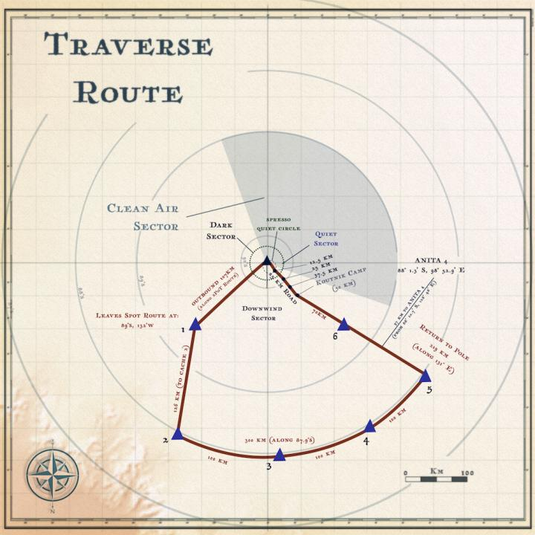
Ground truth at 88 degrees S
Ground traverse (image from NASA SVS)
Airborne laser-altimetry data from ATM

Slide 24
ATL06 relative calibration from ATM airborne laser altimetry data
Segment residuals:
Error per segment is 6-7 cm
Orbit-median residuals:
Error per orbit (averaged over segments) is 3-4 cm
Orbit-median trends
Drift in height biases is 0.3-0.5 mm/day

Slide 25
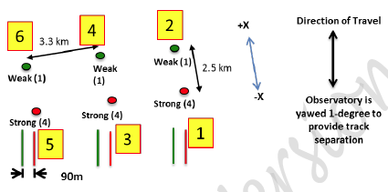
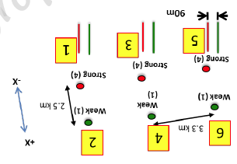
ICESat-2 absolute calibration from Polehole Traverse GPS
ICESat-2 (ATL03, rel209, 14 Oct – 3 Feb) vs GPS data:
Spot | Bias (std), cm | N
1 | +1.2 (9.0) | 127
2 | +2.5 (7.1) | 110
3 | +3.0 (7.8) | 201
4 | +3.2 (8.4) | 181
5 | +5.7 (10.1) | 262
6 | +6.1 (9.1) | 239
Aggregate | +3.8, SE=0.79
ATLAS Spot:
1) Launched in +x orientation (sc_orient == 1);
TEP spots are 2R and 3R.
2) Post yaw flip, -x orientation (sc_orient == 0);
TEP spots are 1L and 2L.
3) For mapping, TEP ATLAS Spots are 1 and 3.
ICESat-2 (ATL06, rel001, 14 Oct – 1 Feb) vs GPS data
Spot | Bias (std), cm | N
1 | -4.4 (9.8) | 171
2 | -1.3 (8.6) | 177
3 | +0.6 (9.6) | 506
4 | +0.7 (9.4) | 490
5 | +1.4 (9.0) | 499
6 | +1.6 (10.3) | 479
Aggregate | +0.4 SE=0.68
Credit (data+figure) : Kelly Brunt

Slide 26
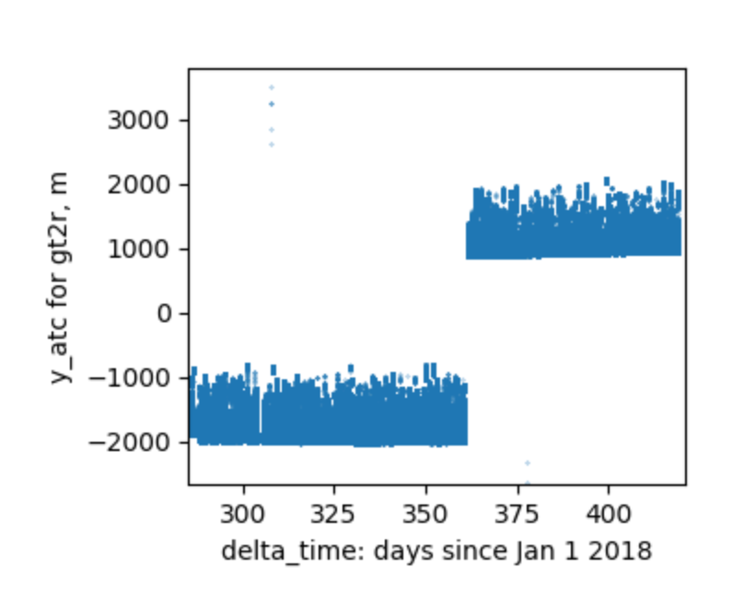
What about those asterisks?
For the first two cycles of operations, there was a software problem with the star trackers. ICESat-2 pointed 1-2 km away from the RGT
The problem was fixed in mid March, and the old data have been reprocessed with corrected pointing. Geolocation and vertical accuracy are better than required.
…But: we only started making repeat-track measurements in March.
Mission cycle 3 is being measured on the RGTs.
The two previous cycles are offset significantly
We can start making repeat-track-difference calculations when cycle 3 is processed, late this summer.
The first two cycles provide better-than-expected resolution for comparisons with ICESat-1 and IceBridge, and for DEM generation

Slide 27
Where to learn more:
The ICESat-2 webpage (https://icesat-2.gsfc.nasa.gov):
Links to the Algorithm Theotretical Basis Documents:
KMLs of ground-track locations (under Tech Specs)
Animations
The NSIDC landing page (https://nsidc.org/data/icesat-2):
Product format descriptions
Data file naming conventions
News on data releases
Known issue descriptions
Data(!)

Slide 28
Can we see ICESat-2 during the hackweek?
Probably not: Passes over western Washington are at ~11:40 GMT, or ~4:40 AM PDT. Sunrise is ~5:10 AM
If you want to try, the best place is probably on Highway 202 just outside Snoqualmie, WA, Thursday morning.

